Slide 1
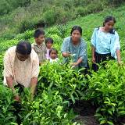
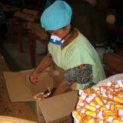

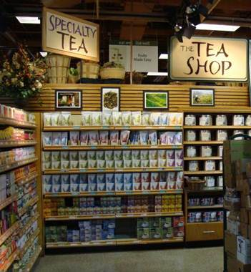
A Guide to Value Chain Guides
A reference database with selection criteria,
recommendations and observations
DDRN GVC conference, 24-25 May 2011
Søren M. Borch
Engineer M.Sc., and Business economist Ph.D.
Value
Chain
Guide
ConDiv, www.condiv.dk, Business innovation consultant, adviser in sustainable value chains
File: www.condiv.dk/gvc-metaguide

Slide 2
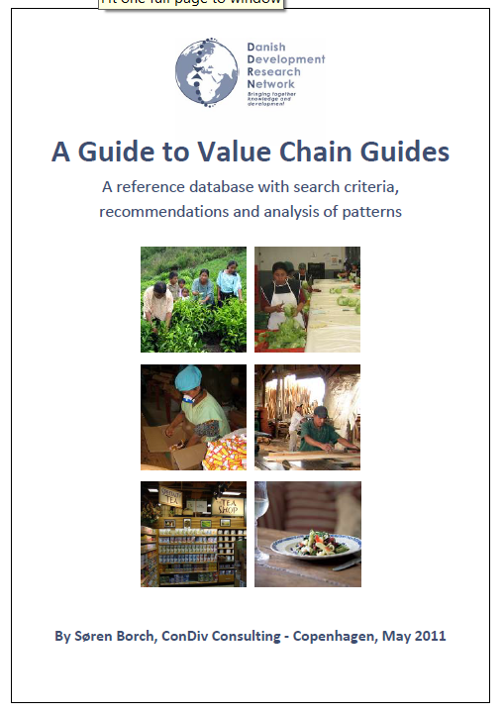
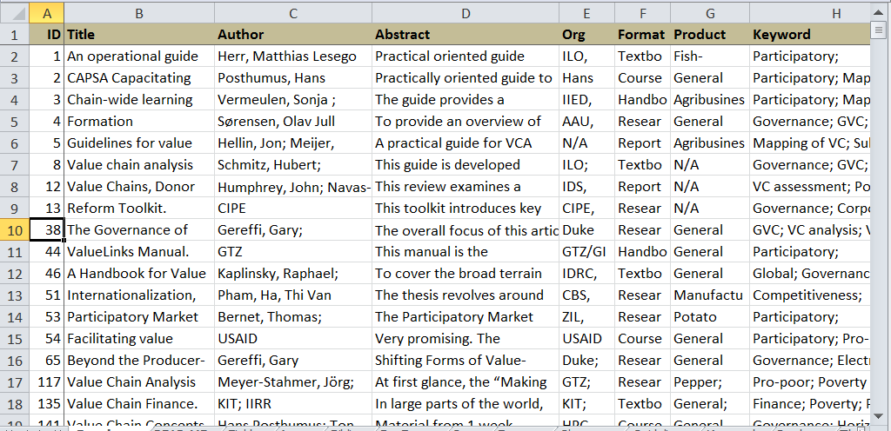
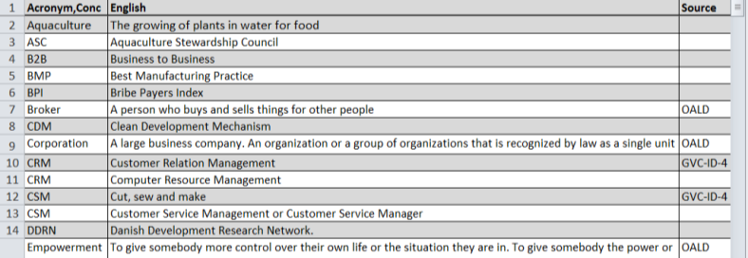
Content of Value Chain Metaguide
Report
Reference database
Glossary database

Slide 3
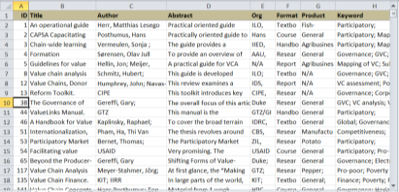
Formats, frequency in sample
Case
story
Guide formats | #
Case story | 3
Consultancy | 1
Course | 4
Faction | 1
Handbook | 6
Manual | 1
Other | 7
Portal | 33
Report | 10
Research | 28
Textbook | 15
Toolbox | 4
Tutorial | 0
(Not classified) | 53
Total sample | 157
Manual
Web-
portal
Research
Toolbox

Slide 4
Formats and their bias
Action
doing
concrete, specific
practical, pragmatic
Toolbox
Manual
Consultancy
Course material
Short
few words
filtered, simplified
focused angles
Extensive
many words
detailed
many angles
Case story
Faction
Handbook
Portal
Tutorial
Report
Cognition
understanding
general
theory, abstract
Textbook
Research

Slide 5

Use the reference database
An operational guide to local value chain development. Combining Local Economic Development (LED) with Value Chain Development (VCD) to strengthen competitiveness and integration of SMEs into markets
Scroll
Search
Filter
Sort
Open
Copy
Add fields
Add guides
Analyse

Slide 6
Method
How
Interviewed potential users to focus the demand for VC guides.
Scrutinised and categorised value chain guides.
Inserted references into a spreadsheet database.
Analysed the guides.
Why
Recommendations on value chain guides.
Patterns in the market of production and demand for value chain guides.
Tool for VC guide users. Easy search, sort, copy, add, build-on.

Slide 7
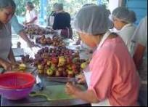
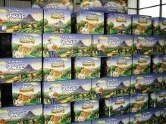
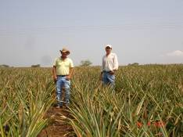
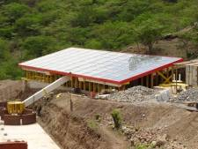
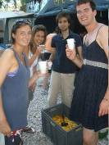
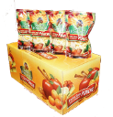


A Value Chain: Sundried fruit
Suppliers
Producer
Clients
Preparation
Individual farmers’ and groups’ production
Supermarkets
Markets
México, USA, Europe
Drying with Solar Energy
Packing and
design of
display products
Transport

Slide 8
Actors around the Value Chain
Environment
VC supporters
VC Influencers
VC operators

Slide 9
Actors and User profiles, overview
Abbrev. | Actors in value chains | User-profile
Value Chain Operators
Micro | Micro business | Micro-Michael
SME | Small and Medium-sized Enterprise | SME-Sofía
Corp | Corporation | Corp-Christian
OtherOper | Other chain operator | Oper-Oscar
Value Chain Supporters
Supplier | Supporting suppliers and subsuppliers | N/A
BSP | Operational business service provider | N/A
Finance | Finance service supplier | Bank-Benny
Field-Con | Consultant in the field | Field-Fatima
Prg-Advis | Development programme adviser | Program-Peter
Value Chain Influencers
Coop | Cooperative | N/A
Soc-Partn | Social partners | N/A
Gvrm-Poor | Government in a poor country | GovP-George
Dev-Inst | Development institutions and companies | Dev-Daisy
Academic | Academic researcher | Academic-Adam
Teacher | Teachers and students | Teacher-Teresa
Donor | Donors, private or government | Donor-Doreen
NGO | Non-Governmental Organization | N/A
Public | Public | N/A

Slide 10
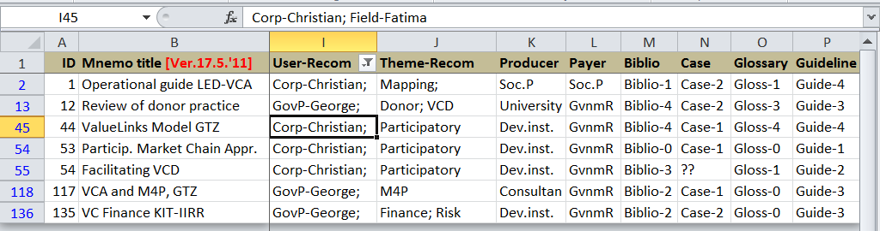
Filtering for User profile = Fatima
Recommended VC guides for Fatima:
ID-54 ("Facilitating value chain development". This is a free training curriculum from USAID)
ID-53 ("Participatory Market Chain Approach" from ZIL)
ID-44 ("ValueLinks Manual. The Methodology of Value Chain Promotion" from GTZ)
ID-1 ("An operational guide to local VC development. Combining ... LED.. with VCD" ILO).

Slide 11
Profile of field consultant, “Fatima”
Fatima – her job
Employee in a local development organisation for an international donor
Primary contact to a medium size value chain in macadamia nuts
Occasionally hires a local (or international) business service provider
Fatima – personal background
Master's degree in development studies 8 years ago
Action-oriented rather than cognition-oriented
Preconception that research material is not really useful.
Fatima’s preferred type of VC guides
Tutorial or handbook on VC development
Tools and models to copy
Help to come from design to reality
Themes: empowerment, entrepreneur, risk, ....

Slide 12
Purpose of profiles
The purposes of the profiles are:
visualising users in flesh and blood, understanding their needs
supporting development of user-friendly functions in the reference database
helping users with a similar profile to find an initial selection of guides
understanding the market for VC guides

Slide 13
Users groups
Operators
Microbusiness
Doer
SME
Corporation
Other operators
Supprt. supplier
Supporters
BSPs
Finance suppl.
Cooperatives
Donor paid
Political goals
Development VC
Field consultant
NGOs
Market paid
Profit goals
Operational VC
Social partners
Develpmt .inst.
Govrnm.poor
Influencers
Dev. prg.adviser
Public
Donors
Academics
Observer
Teacher,student

Slide 14
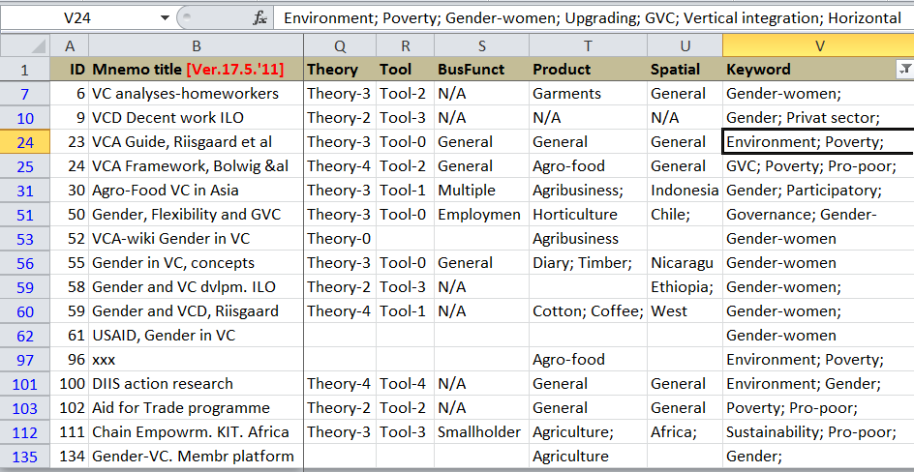
Filtering for a theme: “Gender”
Gender. Start with:
ID-58 ("Making the Strongest links. A practical guide to mainstreaming gender analysis in value chain development" handbook from ILO),
ID-59 ("Gender and Value Chain Development. Evaluation study" research paper from DIIS)
ID-61 ("Handbook. Promoting gender equitable opportunities in Agricultural Value chains" from USAID)
ID-55 ("Pautas Conceptuales y Metodológicas: Análisis de Género en Cadenas de Valor" from SNV).

Slide 15
Themes, frequency in sample
Theme Format | Cluster | Competitiveness | Donors | Export | Faire trade | Finance | Gender | Governance | Indigenous | Institutional | LED | M4P | Mapping | Middleman | Monitoring | Participatry | Risk | Subs./VC analysis | VCD approach
Case story |  | 1 |  | 1 |  |  |  |  |  |  |  |  | 1 |  | 1 |  |  | 3 | 1
Consltncy |  |  |  |  |  |  |  |  |  |  |  |  | 2 |  |  |  |  | 1
Course |  | 1 |  |  |  | 1 |  | 1 |  |  |  |  |  | 1 |  | 2 |  | 3 | 1
Faction |  |  |  |  |  |  |  |  | 1
Handbook |  | 2 |  |  |  | 1 | 2 | 1 |  | 1 | 1 |  | 3 |  | 1 | 2 |  | 2 | 1
Manual
Other |  |  |  |  |  |  | 1 | 1 |  |  |  |  |  | 1 |  |  | 1
Portal |  |  |  | 2 | 2 | 3 | 2 | 3 |  |  |  | 1 | 1 | 1 | 1 |  |  | 1 | 3
Report | 2 | 1 | 1 |  |  |  |  | 1 |  |  |  |  | 2 | 1 |  | 1 | 1 | 2 | 2
Research | 1 | 3 |  | 1 | 1 |  | 7 | 8 |  | 1 | 1 | 1 |  | 1 |  | 3 | 1 | 3
Textbook | 1 | 5 | 1 |  |  | 1 | 2 | 4 |  |  | 1 |  | 4 | 1 | 1 | 4 | 2 |  | 1
Toolbox | 1 |  |  |  |  |  | 1 | 2 |  |  | 1 |  | 1 |  |  |  |  | 5 | 3
Tutorial
Undefined |  | 1 |  | 1 |  | 1 | 1 |  |  |  |  | 1
Total | 5 | 14 | 2 | 5 | 3 | 7 | 16 | 21 | 1 | 2 | 4 | 3 | 14 | 6 | 4 | 12 | 5 | 20 | 12
... a ”Quick-and-Dirty” analysis

Slide 16
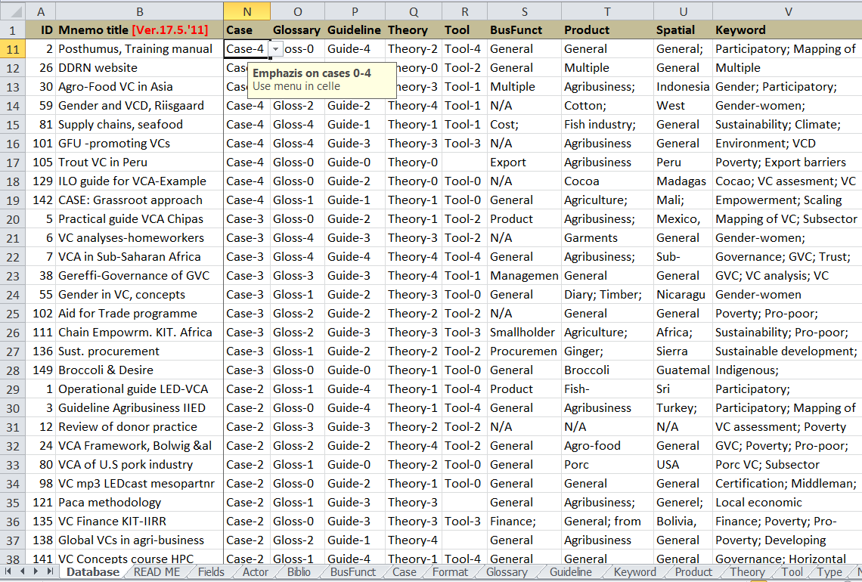
Sorting by ranked keyword: “Case”
Case-4 > Case-3 > .... > Case-0
Supplementary explanation

Slide 17
Keywords for selection
Bibliographical data
Year, Start and End page, Language, Organisation, Publisher's address, ISBN, URL etc.
Format
Case story, course material, handbook, manual, website portal, textbook, toolbox, or tutorial, etc.
Ranked keywords
With scales, e.g. Tool-4>Tool-3>....>Tool-0:
Bibliography: ..... leads on to more references
Case: ....examples from specific cases
Glossary: .... concepts and acronyms
Guideline: ... degree of step by step guidelines
Theory: ..... level of theory (focus on concepts and models)
Tool: ..... the character of a tool
Context keywords
User, Payer and Producer: ... used to analyse patterns in the market for VC guides.
Business functions: .... marketing, QC, sales, HRM, management etc.
Product or sector: ... agribusiness, agriculture, tourism, fish farming, coffee, mango etc.
Spatial: ... Africa, Kenya, Guatemala, etc.
Themes
(all in one field "Keyword“ for easy filtering, search and sorting, standard values (spelling) of these)
Frequent: gender, participatory, mapping, poverty, environment, governance, VC analysis, etc.
Other: competitiveness, empowerment, certification, technology, action research, LED etc.
Free text
Title: Official title in its original wording.
Abstract: Often selected phrases from the document itself.
Notes: This field contains keywords inside phrases formed as natural language.

Slide 18
Dynamics of development
Development support
Advise
Facilitate
Train
Analyse
Design
Revise
Final state of OVC
Intermediary state of OVC
Generations of the operational VC
Initial state of Operational
Value Chain

Slide 19
Development Value Chain
Donor paid development value chain
Sponsoring
Financial flow
Influencers:
Research
Product flow
Supporters:
Analyse
Design
Advise
Facilitate
Train
Revise
Learn
Products and spin-offs: Value chain guides and Programme reports
VC Analysis
Manual
Research
report
Toolbox
Training
material
Web-
portal
Moni-
toring
report
.... with expected effects on the operators in the operational value chain ...

Slide 20
Producers of VC guides in sample
Producer Format | Microbusiness | SME | Corporation | Oper+ | Supplier | BSP | Finance | Filed consult | Prgm adviser | Cooperatives | Social partner | Gvrnm poor | Devel. Institut. | University, Academics | GvnRich | NGOs | Public | N/A
Case stry |  |  |  |  |  |  |  | 1 |  |  | 1 |  | 1
Consultnc |  |  |  |  |  |  |  |  |  |  |  |  |  | 1
Course |  |  |  |  |  |  |  | 2 |  |  |  |  | 1 | 1
Faction |  |  |  |  |  |  |  |  |  |  |  |  |  |  |  |  | 1
Handbook |  |  |  |  |  |  |  | 1 |  |  | 6 |  | 4 | 1
Manual |  |  |  |  |  |  |  |  |  |  |  |  |  |  |  | 1
Other |  |  |  |  |  |  |  | 1 |  |  | 3 |  | 1 |  | 1 | 1
Portal |  |  |  |  |  |  |  | 1 |  |  |  |  | 25 | 4 |  | 1
Report |  |  |  |  |  |  |  | 2 |  |  |  |  | 4 | 2 |  |  |  | 1
Research |  |  |  |  |  |  |  | 2 |  |  |  |  | 10 | 12 |  | 1 |  | 3
Textbook |  |  |  |  |  |  |  |  |  |  | 9 |  | 4 | 2
Toolbox |  |  |  |  |  |  |  | 1 |  |  |  |  | 2 |  |  | 1
Tutorial
N/A |  |  |  |  |  |  |  | 2 |  |  | 1 |  | 4 | 1 |  |  |  | 1
Total* |  |  |  |  |  |  |  | 13 |  |  | 14 |  | 50 | 23 | 1 | 5 | 1 | 5

Slide 21
Payers of VC guides in sample
Payer Format | Microbusiness | SME | Corporation | Oper+ | Supplier | BSP | Finance | Field consult | Prgm adviser | Cooperatives | Social partner | Gvrnm poor | Devel. Institut. | University, Academics | Fund GvrRich | NGOs | Public,Rea-der/student | N/A
Case story |  |  |  |  |  |  |  |  |  |  | 1 |  |  |  | 2
Consultnc |  |  |  |  |  |  |  |  |  |  |  |  |  | 1
Course |  |  |  |  |  |  |  |  |  |  |  |  |  | 1 | 1 |  | 2
Faction |  |  |  |  |  |  |  |  |  |  |  |  |  |  |  |  | 1
Handbook |  |  |  |  |  |  |  |  |  |  | 6 |  |  |  | 7
Manual
Other |  |  |  |  |  |  |  |  |  |  | 3 |  |  |  | 2 | 1 |  | 1
Portal |  |  | 1 |  |  |  |  |  |  |  |  |  | 1 | 3 | 21 | 5 |  | 1
Report |  |  |  |  |  |  |  |  |  |  |  |  |  |  | 7 |  |  | 2
Research |  |  |  |  |  |  |  |  |  |  |  |  |  | 12 | 10 | 1 | 1 | 5
Textbook |  |  |  |  |  |  |  |  |  |  | 9 |  |  | 2 | 4
Toolbox |  |  |  |  |  |  |  |  |  |  |  |  |  |  | 3 | 1
Tutorial
N/A |  |  |  |  |  |  |  |  |  |  | 1
Total* |  |  | 1 |  |  |  |  |  |  |  | 14 |  | 1 | 19 | 57 | 8 | 4 | 9

Slide 22
User Demands vs Supply
User Format | Microbusiness | SME | Corporation | Oper+ | Supplier | BSP | Finance | Field consult | Prgm adviser | Cooperatives | Social partner | Gvrnm poor | Devel. Institut. | Academics | Teacher student | Donor | NGOs | Public
Case story |  | x | x | x |  |  | x | xx | x |  | x |  | xx | xx | x | x | x | x
Consultncy | x | x |  |  |  |  |  | x | x |  |  | x | x |  |  | xx
Course | x | x |  |  |  |  |  | x |  |  |  |  | x | x | x
Faction |  | x | x |  |  |  |  | xx |  |  |  |  | x | x | x | xx
Handbook | x | x | x | x |  | x | x | xxx | xx | x | x | x | xxx | xx
Manual | x | x | x |  |  |  |  | x |  |  |  |  | x
Portal |  |  | x |  |  |  |  | x | x |  | x |  | x | x | x | x | x | x
Report |  |  |  |  |  |  |  | x |  |  | x |  | xx | xx |  | x
Research |  |  |  |  |  |  |  | x | x |  |  | x | xx | xxx | x | x | x
Textbook |  |  | x |  |  |  | x | xx | xx |  | x | x | xx | xx | xx | xx
Toolbox |  | x | x |  |  |  |  | x | x |  | x |  | xx | x
Tutorial | x | x | x | x |  | x | x | xxx | xx | xx | x | x | xx | x | xx | xx | xx | xx
In demand
Supply
Users’ demand

Slide 23
Top-10 VC guides
ID | User-recom | Theme-recom | Notes
12 | 4 | 2 | "Value Chains, Donor Interventions and Poverty Reduction: A Review of Donor Practice", IDS
1 | 3 | 2 | "An operational guide to local value chain development. Combining Local Economic Development (LED) with Value Chain Development (VCD) to strengthen competitiveness and integration of SMEs into markets", ILO
8 | 3 | 2 | "Value chain analysis for policy-makers and practitioners", ILO
111 | 3 | 1 | "Chain Empowerment: Supporting African Farmers to Develop Markets", KIT
135 | 2 | 2 | "Value Chain Finance. Beyond microfinance for rural entrepreneurs", KIT
2 | 2 | 1 | "CAPSA Capacitating Sector Analyses. A practical training methodology to analyse value chains. Training Manual for the participants", HPC, SNV
44 | 2 | 1 | "ValueLinks Manual. The Methodology of Value Chain Promotion", GTZ
53 | 2 | 1 | "Participatory Market Chain Approach", ZIL
54 | 2 | 1 | "Facilitating value chain development. A new training curriculum from USAID", USAID
117 | 2 | 1 | "Value Chain Analysis and “making markets work for the poor” (M4P). Poverty reduction through value chain promotion (Draft)", GTZ
Top references according to sum of recommendations
.... a “Quick-and-Dirty” analysis

Slide 24
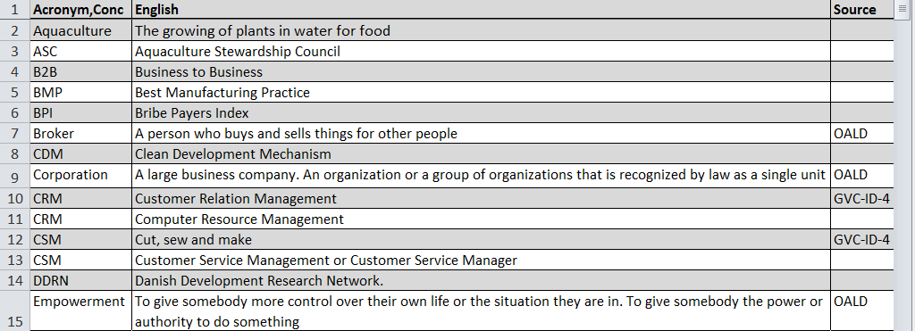
Use the glossary
Scroll
Search
Copy
Add

Slide 25
Summary
Report
Reference database
Summary
Report with recommendations and analyses
Reference and glossary database as tools
Users, themes, concepts
Understanding of the market for VC guides.
You are welcome to use the VC Metaguide !
..... and to contribute with more references ☺
Glossary database

